Slide 1
Download the App “Mentimeter” OR Go to www.menti.com
Use the code
907543

Slide 2
Social Development and Children Who Are Deaf or Hard of Hearing
Joni Alberg, PhD
Yale Alberg & Associates
April 9, 2018

Slide 3
What I will be talking about...
Skills
Self Esteem
Social Development and Children Who Are D/HH
Measuring Skill Acquisition
Instructional Strategies

Slide 4
Social behavior is the one subject on which children are graded every single day.

Slide 5
Notes:
LiveSlide Site
https://www.mentimeter.com/s/060de414431561939a5e4b0db5b31fa1/07563c319baf/edit
W

Slide 6
Developing Social Skills
Children begin the process of socialization as soon as they are born.
Notes:
Learn from family and community
They may learn good social skills
Or they may learn bad social skills --- examples
Therefore they must be taught
Developmental milestones
VERY WELL.com

Slide 7
Social Skill Groupings
Foundational skills
Interaction skills
Affective skills
Cognitive skills
Notes:
Helpful to categorize social skills in some way—makes it easier to focus on skill groupings. This is one way.

Slide 8
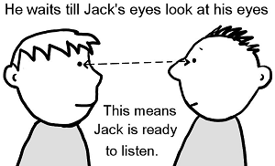
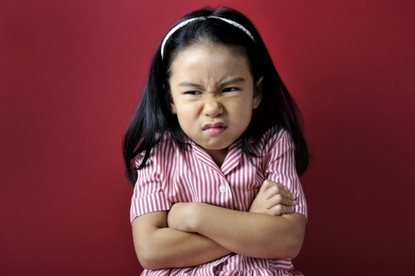
Foundational Skills
Notes:
What skills would you consider as “foundational?”
Eye contact
Reading the emotional signals of others
facial expressions
body language
Personal space
Self regulation

Slide 9
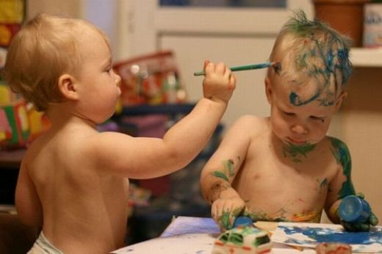
Interaction Skills
Notes:
Resolving conflict
Making friends
Taking turns
Sharing
Initiating and ending conversations

Slide 10
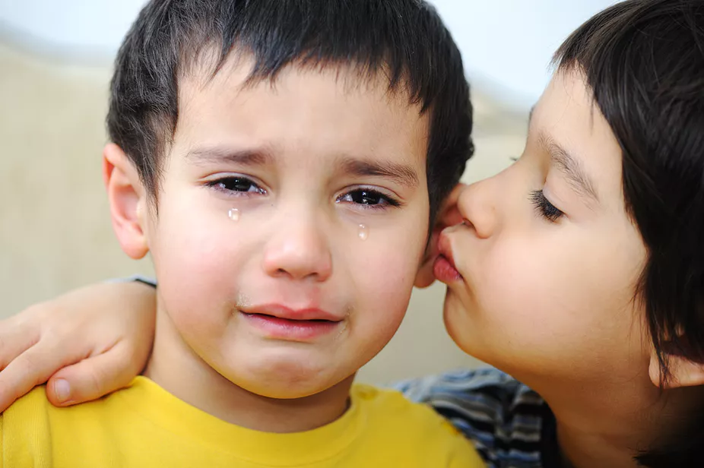
Affective Skills
Interaction skills
Notes:
Idetnifying own feelings
recognizing feelings of others
Empathy
Determining if someone is trustworthy --

Slide 11
Cognitive Skills
Cognitive Skills
Notes:
Making choices
Understanding community norms
Determining appropriate behavior to use in different social situations

Slide 12
Self Esteem
Most fears of rejection rest on the desire for approval from other people. Don't base your self-esteem on their opinions.
Harvey Mackay
Notes:
Goal is for children to develop positive self esteem
Worth as an individual
How we see our perceived value to the world and others
Gives us strength and flexibility to take charge of our lives and grow from our mistakes without fear of rejection
High self esteem individuals are more likely to persist in the face of failure.
SES
Must be on the lookout for low self esteem and immediately develop a plan to address it.

Slide 13
Research Has Shown...
Classroom participation is the greatest single predictor of social success for school aged children.

Slide 14
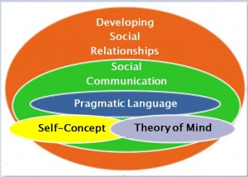
Interrelated Construct of Social Skills
© Karen Anderson
Notes:
Why the construct is important
Shows how everything interconnects.
Language is at the center

Slide 15
Social behavior is the one subject on which children are graded every single day.

Slide 16
Notes:
LiveSlide Site
https://www.mentimeter.com/s/409018a203f64da2d9be783407b418e0/849ef3ec9e5a/edit

Slide 17
Functional hearing
Functional communication
Speech intelligibility
Spoken language reception/expression skills
Maturation
Quality of hearing technology and use of hearing
Age of diagnosis
Age of audiological & educational interventions
Home languages other than English
Communication participation
Preferred mode of communication
Participation in school and community activities
Parent participation in the student’s education
Teacher-parent communication
Notes:
Language nuances—example---I love your outfit! (nicely) I love your outfit (sarcastically)

Slide 18
Success is typically measured in terms of language and academic achievement comparable to hearing peers.

Slide 19
Imperative social achievement be included in overall measurement of success.

Slide 20
Assessment
Does child have the necessary language for social interactions?
Does child have the necessary underlying social skills upon which they can achieve higher-order skills?

Slide 21
Types of Assessments
Teacher observation
Parent observation
Student self assessment
Notes:
Parents may see their children differently than the children see themselves.

Slide 22
Instructional Strategies
Direct instruction
Role play
Auditory practice

Slide 23
http://infanthearing.org/ebook-educating-children-dhh/index.html

Slide 24
Social behavior is the one subject on which children are graded every single day.

Slide 26
Notes:
LiveSlide Site
https://www.mentimeter.com/s/b081e410d8861f42e2d7b10258ca2422/0fa7513a1894/edit

Slide 27
Copy of this PPT is available on my website
www.yalealberg.com

